Slide 1
How the Swiss roll
Jolanta Lebioda
27th July 2017
Notes:
In May Hannie and I went to Switzerland with the Swiss Intern Program. We’d like to tell you what we did, what we saw, and what we learnt.
So I will give you a quick overview of the program, the places we visited, and tell you about the library education in Switzerland.

Slide 2
What is the Swiss Intern Programme?
Erasmus/Leonardo Programme
Britta Biedermann
Swiss Education Delegation for Information and Documentation
Swiss Library Association
Notes:
The Swiss Intern Program is organised by the Swiss Education Delegation for Information and Documentation. This is an independent organisation of the Swiss Library Association. The Education Delegation participates indirectly in the Leonardo da Vinci and Erasmus European vocational training programs. So the program is open to holders of a Federal Vocational Diploma in information and documentation. Interns benefit from financial support towards their expenses, as well as a flat-rate travel allowance. Britta Biederman is the manager of the programme and cooperates with libraries and archives across Europe. She is also head Librarian at the Institute of Sociology Library at University of Zurich. And she also organised our very active stay in Switzerland.

Slide 3
Notes:
A good thing about being an intern on this programme was that we could contact any library or archive in Switz. And ask for a visit. So Hannie and I had the opportunity to add a couple of places to the program organised by Britta. So here are the places that we visited between us:
Polish museum – it’s just outside Zurich, half an hour on the train but we went there the scenic way, on a boat across Lake Zurich
Social Archives – an academic library and historical archive that was created at the beginning pf the 20th century to collect documents concerning social questions – unions, political and social movements, migration etc..
Sociology Library where Britta works,
Eng. Dept. Lib
Central Lib – where we met Alice Keller - about which I’ll talk a little more on the next slide
Swiss Nat. Museum Lib – where we met previous years interns that came to Oxford, and where Dominic works.
Hannie went to St. Gallen to visit one of the most beautiful libraries in the world
I went to visit the Red Cross Library – a nostalgia trip, because as a teenager, I was a RC volunteer for many years. It was a fascinating experience to see where it started and touch the historical documents related to these beginnings.
Finally We went to Bern to the University Library – We went together with the previous years interns to meet with the two of 2017.
We also participated in the bilingual lesson in a library school.

Slide 4
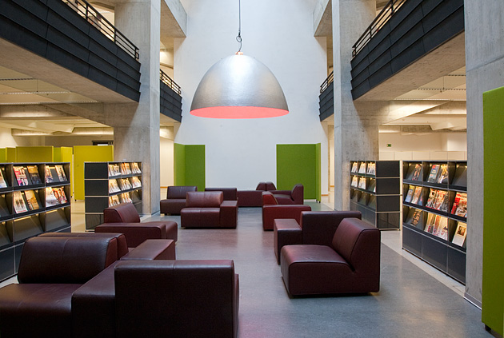
Town and Gown - Zurich Central Library
University Library
Cantonal Library
City Public Library
Special Collections and Archives
„Die Leselounge in der ZB“ [digital image] retrieved from: https://www.zb.uzh.ch/ueberuns/index.html.en
Notes:
One of the surprising library features during our visits was the Central Libraries combination of services and missions they provide. This was most visible in the Central Library in Zurich, but also in the University library in Bern.
The Zentralbibliothek Zürich - With over six million documents and more than half a million visitors per year, the Zentralbibliothek Zürich is one of the largest Swiss libraries (https://www.zb.uzh.ch/ueberuns/index.html.en)
It serves as:
A university library so it collects scientific literature on all the subjects taught at the University of Zurich. Smaller departmental libraries with more modest budgets and less space, are in regular contact with the Central Library and ask for a title to be added to the collection as they will not be able to purchase it. So for ex. The Eng. Dept. Library was for me surprisingly small but after talking to the librarian, it became clear that a lot of the subject titles were accessible in the Central Library.
its capacity as the cantonal library, the Central Library follows the regional mandate to collect and archive Zurich-related media, also known as "Turicensia". It collects all publications published by Zurich-based publishing houses, all works of Zurich-based authors and all literature on Zurich itself.
As city library the Central Library offers a wide selection of popular literature . It’s collections are open to anyone with proof of address. There isn't a clear distinction between academic and non-academic material. A member of public can borrow any non-confined material, regardless of their academic status, even if it’s the most used reading-list title and it’s exam time.
Special Collections
Information cited and ‘Die Leselounge in der ZB‘ [digital image] retrieved from: https://www.zb.uzh.ch/ueberuns/index.html.en

Slide 5
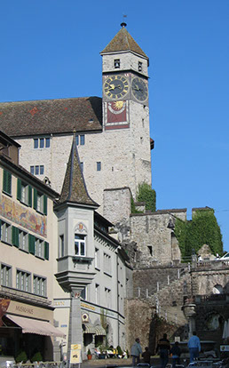
Polish Museum & Library - Rapperswil
Founded in 1870
91.000 prints, 27.000 manuscripts, 10.000 photographs
1918 – Poland gained independence
1927 – collections transported to Poland
A. Piotrowska, ‘Kamienica Burghof’ [digital image] retrieved from the museum’s website: http://www.muzeum-polskie.org/mpr/polski/informacje.html
Notes:
The Polish Museum, Rapperswil, was founded in 1870, by Polish aristocrat in exile Władysław Plater. Its mission was to be a repository for Polish historic memorabilia, and a library and archives of the Great Emigration.
As you might know in the late 18th century Poland had disappeared from the maps, annexed by its powerful neighbours: Russia, Hapsburgs and Austro-Hungarian Empire, and Prussia. A big wave of emigration followed
Plater in his last will bequeathed the collection to Poland and the Polish People, and he asked for the Collections to be taken to Poland when it regained its independence.
The collections consisted of :
91.000 prints (books, periodicals and printed ephemeras),
27.000 manuscripts, diplomas and autographs,
1400 maps and atlases,
over 1.000 musical scores
and about 10.000 photographs,
plus 3,000 works of art,
2,000 historic memorabilia,
20,000 engravings,
9,000 coins and medals.
In 1918 with the Armistice of Compiègne, Poland reappeared on the maps. In 1927 the collection left this castle, it took 14 train wagons to have it transported to Poland. As we know in 1939 2nd WW started and with the bombardment of Warsaw hardly anything from the collection survived. The library and the museum in Rapperswil still exists, but now it’s a much smaller collection of items donated after the war.
Information and A. Piotrowska, ‘Kamienica Burghof’ [digital image] retrieved from the museum’s website: http://www.muzeum-polskie.org/mpr/polski/informacje.html

Slide 6
So how do the Swiss roll?
GDP per capita is one of the highest in in the world
Comes in the top five in the World Happiness Report
Unemployment rate below 4 percent
Switzerland’s vocational education and training (VET) system is a very important contributor to the country’s economic success. *
*Nancy Hoffman and Robert Schwartz, “Gold Standard: The Swiss Vocational Education and Training System” (Washington, DC: National Center on Education and the Economy, 2015).
Notes:
Switzerland’s per capita GDP is the one of highest in the world
unemployment rate below 4 percent (3.1 in Jan 2017).
World Happiness Report –It measures, amongst other things, - GDP per capita, social support, healthy life expectancy, freedom to make life choices:
(http://worldhappiness.report/wp-content/uploads/sites/2/2017/03/HR17.pdf)
So what is the secret???
According to researchers from the Center on International Education Benchmarking - Switzerland’s vocational education and training (VET) system, one of the strongest in the world, is a very important contributor to the country’s economic success. (http://ncee.org/swiss-vet/)
More info: In the report, ’Gold Standard: The Swiss Vocational Education and Training System’, authors Nancy Hoffman of Jobs for the Future and Robert Schwartz of the Harvard Graduate School of Education shed new light on the Swiss VET system, how businesses play—and benefit from—a central role in the training of a highly skilled workforce, and the seamless connections between VET and the broader Swiss education system.

Slide 7
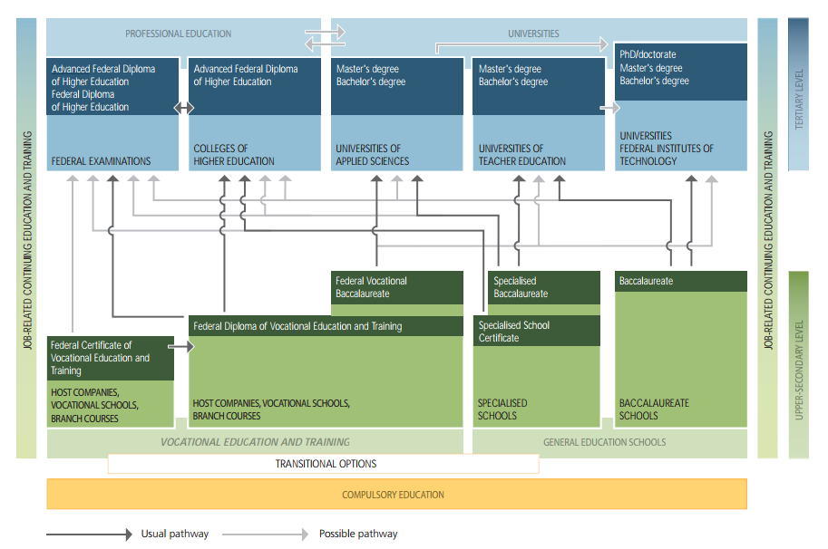
*Chart retrieved from Federal Council Education webpages: https://www.sbfi.admin.ch/sbfi/en/home/bildung/swiss-education-area/das-duale-system.html
Notes:
SO here are the choices that the teenagers have after finishing compulsory education. There is a choice between general education schools – specialized or not; and vocational school or training. Once a decision is taken, it is not set in stone. There are possible pathways and transfers in between these blocks. So a VET apprentice can take A-Levels and go to the university. Also a general education pupil can move to VET school, etc. Hannie will tell you more about the choices made by the interns that came to Oxford.
According to OECD (The Organisation for Economic Co-operation and Development ) statistics - The Swiss can expect to go through 17.4 years of education between the ages of 5 and 39, OECD average is 17.5 years. BUT 88% of adults aged between 25 and 64 have completed upper secondary education, higher than the OECD average of 76%. Again according to OECD Graduating from upper secondary education has been more and more important in all countries, as the skills needed in the labour market are becoming more knowledge-based. Graduation rates therefore provide a good indication of whether a country is preparing its students to meet the requirements of the job market. (OECD (2014), Education at a Glance 2014: OECD Indicators, OECD Publishing. http://dx.doi.org/10.1787/eag-2014-en)
AS the Swiss education system is an important component of the country’s economic engine – the Swiss industry sector partners with the State and is heavily involved in the development of qualifications and assessments, training curriculum, and additional course work for VET students. The system produces highly skilled, ready-to-work new employees for Swiss businesses. Which in turn serves as a real economic incentive for businesses to participate in the scheme.
So the final product is a wide cross-section of students for an expansive range of occupations - including IT, manufacturing and healthcare, and traditional trades and crafts. The system also seamlessly connects young people with white- and blue-collar jobs through a robust apprenticeship system, keeping youth unemployment rates low.
Information cited and chart retrieved from Federal Council Education webpages: https://www.sbfi.admin.ch/sbfi/en/home/bildung/swiss-education-area/das-duale-system.html
Fakten_Zahlen_BB2017_en.pdf
EN_Bildungssystem_cmyk_frutiger (1).pdf

Slide 8
VET – Swiss Educational System
Young people in a setting with adults.
Hands-on learning.
Students are paid while they are learning.
Nationally recognized qualification
Crosswalks and points of transfer between academic and vocational studies.
Nancy Hoffman and Robert Schwartz, “Gold Standard: The Swiss Vocational Education and Training System” (Washington, DC: National Center on Education and the Economy, 2015).
Notes:
It immediately puts young people in a setting with adults, where they are treated differently from in school and given more responsibility, coupled with ample coaching and support.
The learning is much more hands-on, contextualized, and applied: academic concepts are made real.
Students are paid while they are learning, typically the equivalent of about $600- $700 a month to begin with, growing to $1,100- $1,200 by the third year, and this for three to four days of work a week at the most.
And at the end of the apprenticeship they have a nationally recognized qualification that is transferrable, and the opportunity to move directly into full-time employment or to continue on into higher education
And, unlike in some other countries, the Swiss system intentionally provides a number of crosswalks and points of transfer to allow students to move between academic and vocational studies; as well as from VET on to higher education at a university of applied sciences.
Cited after: Nancy Hoffman and Robert Schwartz, “Gold Standard: The Swiss Vocational Education and Training System” (Washington, DC: National Center on Education and the Economy, 2015).

Slide 9
Bilingual Course: School for Librarians
Notes:
Here is the bilingual lesson we participated in. Do you recognise this person here? It’s not a famous librarian.
The day we went was not a library teaching day. The lesson was in English but it the subject was General Studies. And the lesson was about populism. The pupils had to describe the features of the current populistic politics based on examples from different countries. So on that photo is leader of Law and Justice and here these two Swiss teenagers are discussing controversial movements of Poland’s current government.

Slide 10
Interested? Check:
Berufsbildungplus.ch: Everybody Gains By Training Apprentices:
http://www.berufsbildungplus.ch/berufsbildungplus/berufsbildung/international.html
Swiss Education Report 2014:
http://skbf-csre.ch/fileadmin/files/pdf/bildungsmonitoring/Swiss_Education_Report_2014.pdf
OECD: Vocational Education and Training in Switzerland Strengths, Challenges and Recommendations:
http://www.oecd.org/education/innovation-education/45167147.pdf
N. Hoffman and R. Schwartz: Gold Standard: The Swiss Vocational Education and Training System:
http://ncee.org/swiss-vet/
Notes:
Governmental Education websites – professional sector
The Organisation for Economic Co-operation and Development (OECD) - The mission of the Organisation for Economic Co-operation and Development (OECD) is to promote policies that will improve the economic and social well-being of people around the world.
National Center on Education and the Economy - The National Center on Education and the Economy was created analyse the implications of changes in the international economy and education
References:
https://www.zb.uzh.ch/ueberuns/index.html.en
http://www.muzeum-polskie.org/mpr/english/information.html
http://worldhappiness.report/wp-content/uploads/sites/2/2017/03/HR17.pdf
http://ncee.org/swiss-vet
’Gold Standard: The Swiss Vocational Education and Training System’, authors Nancy Hoffman of Jobs for the Future and Robert Schwartz of the Harvard Graduate School of Education shed new light on the Swiss VET system, how businesses play—and benefit from—a central role in the training of a highly skilled workforce, and the seamless connections between VET and the broader Swiss education system.
https://www.sbfi.admin.ch/sbfi/en/home/bildung/swiss-education-area/das-duale-system.html
http://www.oecd.org/education/innovation-education/45167147.pdf

